Slide 1

Results from the Initial Consultation Survey
(February 23, 2016)
Purpose of this presentation:
to inform members about our information gathering (process).
engage members with the process in order to give the Negotiating Team the strongest and clearest mandate possible
initiate thoughts about some key issues in anticipation of the upcoming Town Hall-style meeting on March 11th 2:30-4:00

Slide 2


Slide 4
A preliminary analysis of the numerical responses from the Initial Consultation Survey of StFXAUT members.
For most questions respondents were asked to respond to questions by rating their response on a 7-point Likert scale.
Raw scores were graphed as histograms to view the distribution of responses on the Likert scale. A trendline was then added to the data.
These numerical results will be contextualized by a forthcoming analysis of text-based responses.
Notes:
p

Slide 5
Some preliminary statistics
226 respondents began the survey from a membership complement of 401 persons, representing a 56.4% response rate.
Faculty members represented 61% of respondents
Result: Survey broadly representative, with care needed to ensure minority voice are heard.

Slide 6
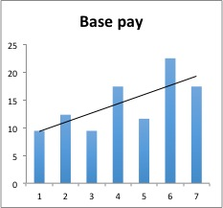
How to speed read the graphs
The slope of the line indicates the balance of opinion and should not be read as having any specific numerical significance (i.e., slope is statistically different (or not) than zero.
Satisfaction or Concern
1 = Least; 4; neutral; 7 = Most

Slide 7
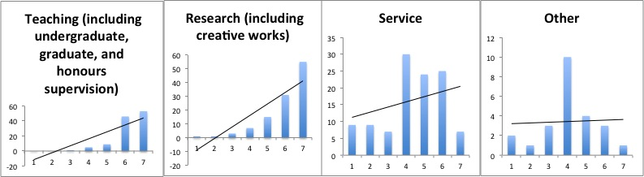
Workfocus: I CAN get satisfaction
This section pertains to Faculty only, so data were sorted by that employment group before analysis
Basic inference: Teaching and Research are both important to workplace satisfaction, whereas service appears to be less so. “Other” activities do not appear to have a strong signal.
NOTE: Honours and Graduate supervision is really teaching and research, so respondents may have varied in their inclusion of those activities in there response. However, when addressing workload equity, this is a critical issue for further discussion.

Slide 8
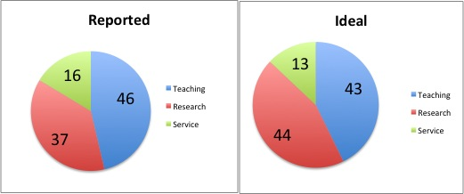
Work Balance
Respondents were asked to estimate the balance of their three principal activities, expressed in number of hours in a typical week that they spend on these activities. Then they were asked about their ideal.
Inference: A slight rebalancing toward research is indicated.
NOTES:
Numbers are expressed as proportions.
Respondents indicated, as typical, a 50 hour work week during the academic year and a 44 hour work week during the summer. Annualized these numbers = an average 48 hour week
Notes:
total numbers do not allow us to parse out instances in which intersession teaching is ocurring.
Another example would Education where there is a full residential summer teaching period.

Slide 9
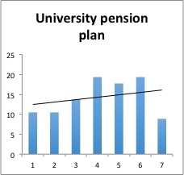
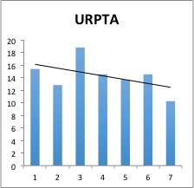
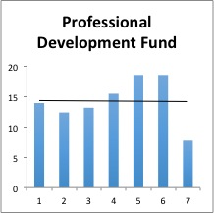
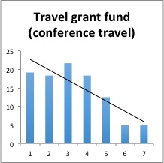
Direct Compensation
Respondents were asked to rate their satisfaction with various forms of direct compensation
Inference: Respondents were generally satisfied with base pay and pension, but not with URPTAs and Travel Funds. Professional Development fund was neutral.

Slide 10
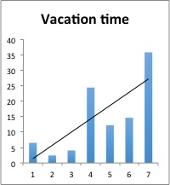
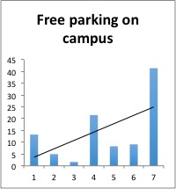
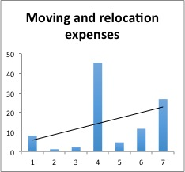
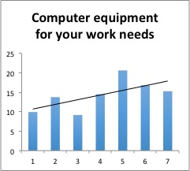
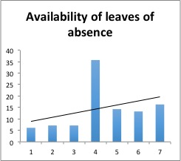
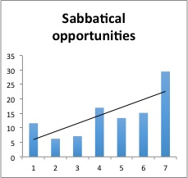
Indirect Compensation
Respondents were asked to rate their satisfaction with various forms of indirect compensation
Vacation time, Free parking, Moving expenses, computer needs, leaves of absence and sabbatical opportunities appear to be generally satisfactory.

Slide 11
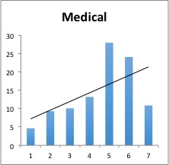
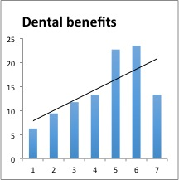
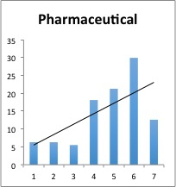
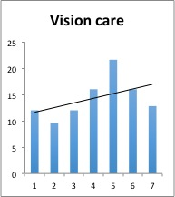
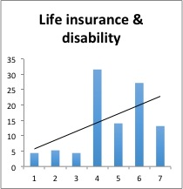
Indirect Compensation (cont’d)
Inference: Various health and wellness benefits appear to be generally satisfactory.

Slide 12
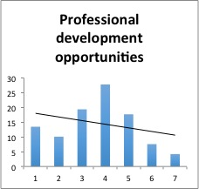
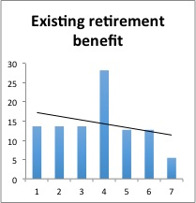
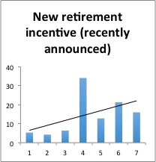
Indirect Compensation (cont’d)
Respondents were asked to rate their satisfaction with various forms of indirect compensation
Inference:
Professional Development opportunities are not deemed generally to be satisfactory.
The new retirement incentive is deemed to be an improvement.

Slide 13
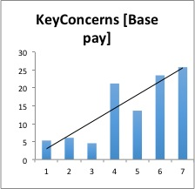
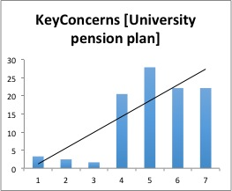
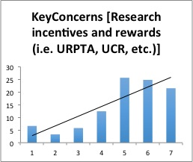
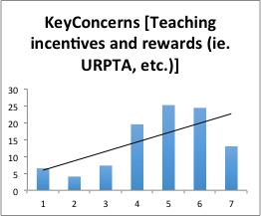
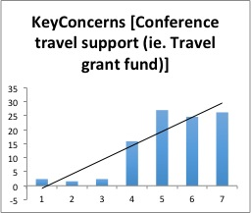
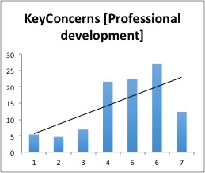
Key concerns, going forward
Respondents were asked to rate the importance of forms of Direct and Indirect Compensation, going forward. (Rising (from left to right) lines mean concern is high)
Notes:
SKIP ALL KEY CONCERNS FOR ORAL PRESENTATION

Slide 14
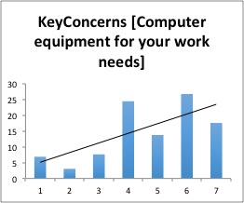
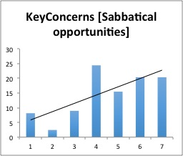
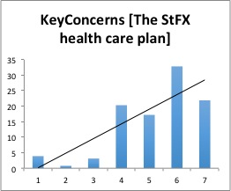
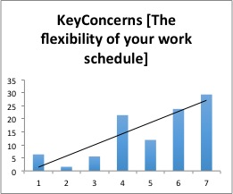
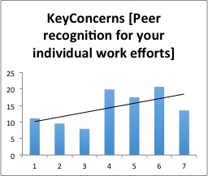
Key concerns, going forward (cont’d)
Respondents were asked to rate the importance of forms of Direct and Indirect Compensation, going forward. Rising (from left to right) lines mean concern is high)

Slide 15
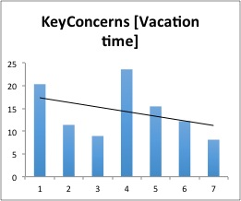
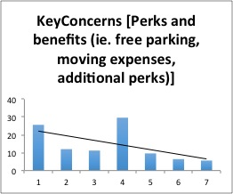
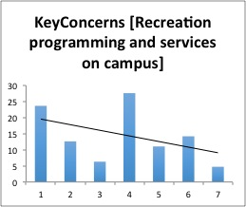
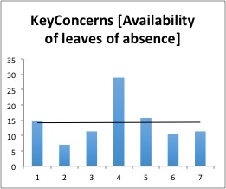
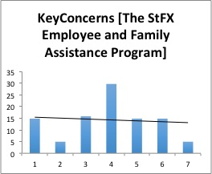
Key concerns, going forward
The following are either NOT key concerns, going forward, or are neutral.

Slide 16
Satisfaction vs. Key Concerns
Here, Satisfaction and Key concerns are presented side by side.
Inference:
Base pay, overall, should be maintained; some employment groups may warrant further investigation.
Gains to the Pension plan are warranted.
Notes:
Instances in which Satisfaction and Concern are pointing in the same direction indicate that whereas gains might be warranted (see for example the Pension Plan), but losses are certainly to be avoided. Instances in which there is a change from low satisfaction (downward or flat trending lines) to high concern, indicate areas where special focus and determination on gains are warranted.

Slide 17
Satisfaction vs. Key Concerns (cont’d)
Teaching and Research were considered separately
Inference: Teaching and Research incentives and rewards and Professional Development should be areas of further focus.

Slide 18
Satisfaction vs. Key Concerns (cont’d)
Inference:
Significant gains on Conference Travel are warranted
Vacation time is not worth pursuing
Indirect Comp

Slide 19
Satisfaction vs. Key Concerns (cont’d)
Inference:
1) Parking and Moving expenses are not worth pursuing.

Slide 20
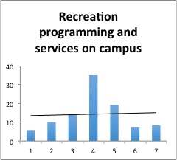
Satisfaction compared to Key Concerns (cont’d)
Inferences:
1) Gains in Professional development opportunities are warranted
2) Gains in Recreation and programming are not a primary focus, but may be for employment groups with lower base pay

Slide 21
Satisfaction compared to Key Concerns (cont’d)
Inference:
Losses to computer provisions are to be avoided
Leaves of absence should not be pursued further, but gains for smaller employment groups may be worth exploring

Slide 22
Satisfaction compared to Key Concerns (cont’d)
Inference:
Sabbatical opportunities continue to be important; losses should be avoided.
Gains to Health Care benefits may not be warranted, but losses are to be avoided (note: the graph for Medical is comparable to dental, life insurance etc.).

Slide 23
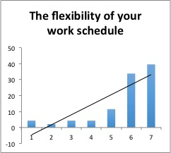
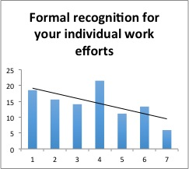
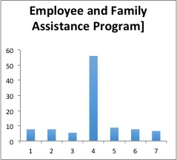
Satisfaction compared to Key Concerns (cont’d)
Non-compensation benefits
Inferences:
1) Flexibility is not particularly an issue,
2) Gains on recognition for individual work efforts may be warranted.
3) The Employee and Family Assistance Program does not appear to be a valued benefit and is not a concern.

Slide 24
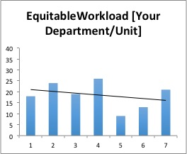
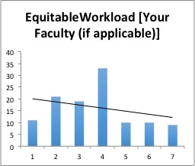
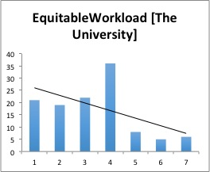
Workload Equity
Respondents were asked to rate whether they believed that Workload was shared equitably (as appropriate) across their Department/Unit, Faculty and the University as a whole
Inference:
There is perceived inequity at all levels.
The more “removed” one gets from their Department, the greater the perceived inequities in workload

Slide 25
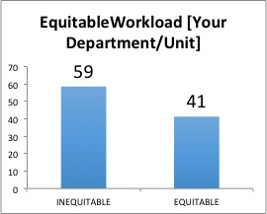

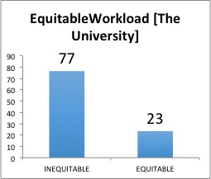
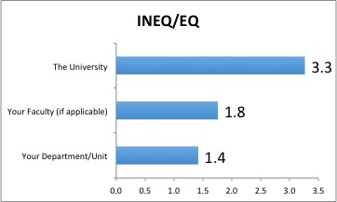
Workload Equity: no shades of gray
Here, to get a higher contrast view, responses on either side of “neutral” were binned together to generate either Inequitable or Equitable
Inference:
Significant progress must be made toward diagnosing the specific reasons for this perception, and devising and implementing a solution.

Slide 26
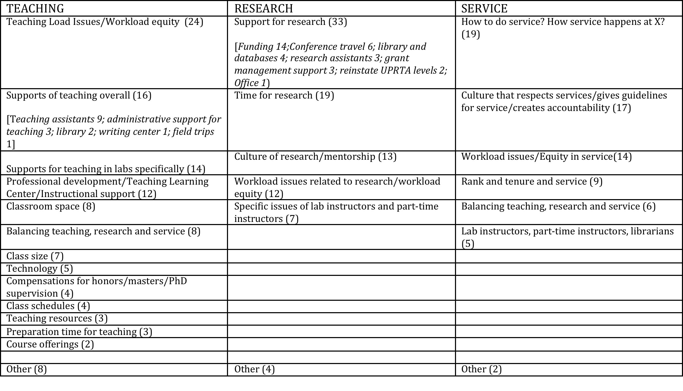
An analysis of text based responses. Responses were categorized by topic and will be used, going forward to frame the next survey.

Slide 27

Correcting for the (numerically dominant) influence of Faculty opinions
Faculty responses were contrasted against respondents from other groups to detect any differences. Differences suggest more attention to the needs and desires of individual groups in the bargaining unit. Only Lab Instructors and Librarians had enough respondents to make graphing the results worthwhile
Please see second power point presentation entitled:
“faculty_lab_lib_matrix_comparison.pptx”

